Slide 1
Coffee
time
THE FUTURE OF ‘WORK FROM HOME’

Slide 2
START HACK 2021
Jordaan
Kai
Andre
Daniel
Our journey
Four tech enthusiasts
Previously unknown to each other
Aligned with a single mission:
To improve the Work-From-Home experience for employees
Across the world…

Slide 3
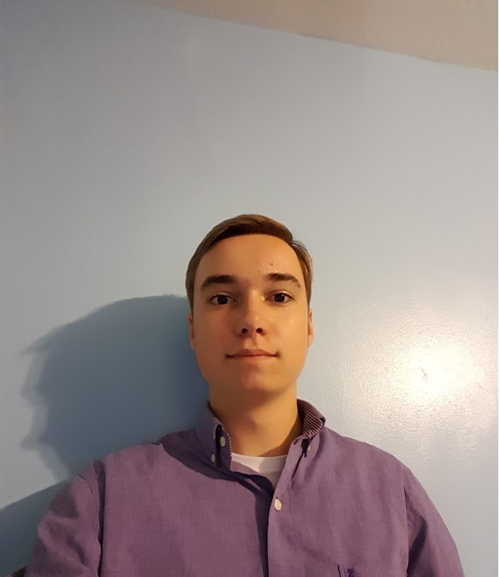
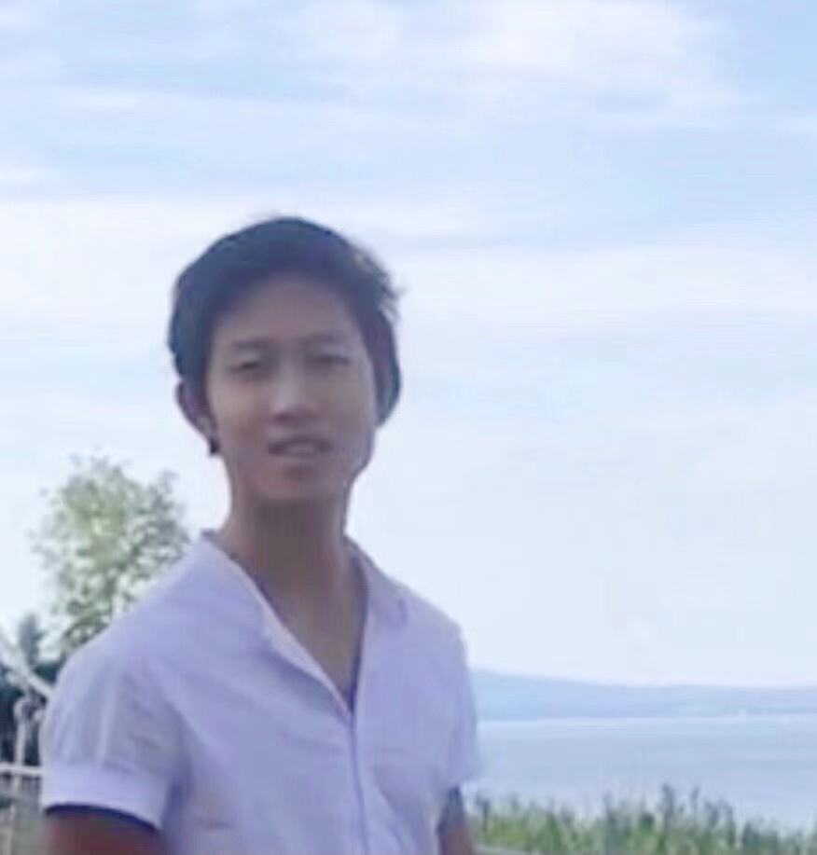
Meet the team
OUR Diverse skill-set
Jordaan Wolfson
BSc. Accounting & Finance, University of Warwick
IBM Certified Enterprise Design Thinking Practitioner, Co-Creator & Coach
Project Management, Finance, Strategy and Learning & Development
Andre Emenegger
Bsc. Computer Science, ETH Zurich
Experience in Algorithms, Data Science and Video Production
Java and Android
Kai Zheng
BSc. Computer Science, Swiss Federal Inst. Technology
Experience in UX/UI design
Android and iOS development
Daniel Rosen
Self-taught Programmer
Experience in Machine Learning, NLP and Data Vision
Full-stack Web Dev and iOS

Slide 4
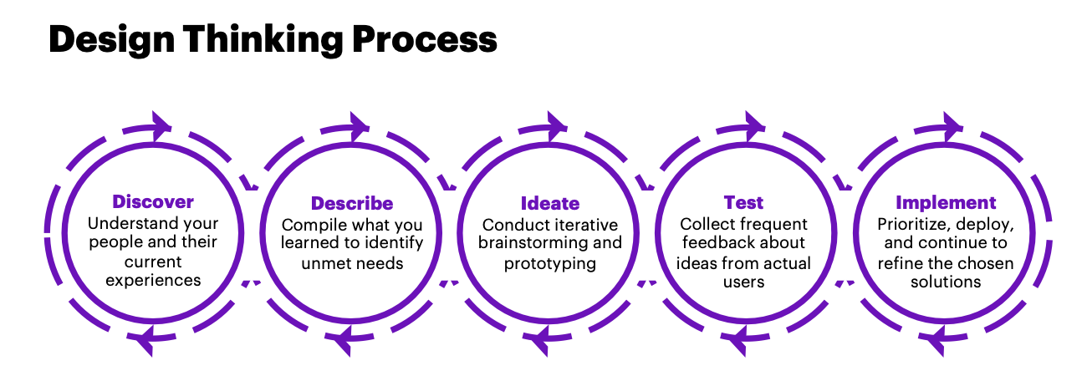
OUR Methodology
KEY COLLABORATION tools
Enterprise
Design
Thinking
Discord (voice chat & resource sharing)
Miro (brainstorming & flow charts)
WhatsApp (Out-of-Hours chat)
Git/Github (iOS & website dev)

Slide 5
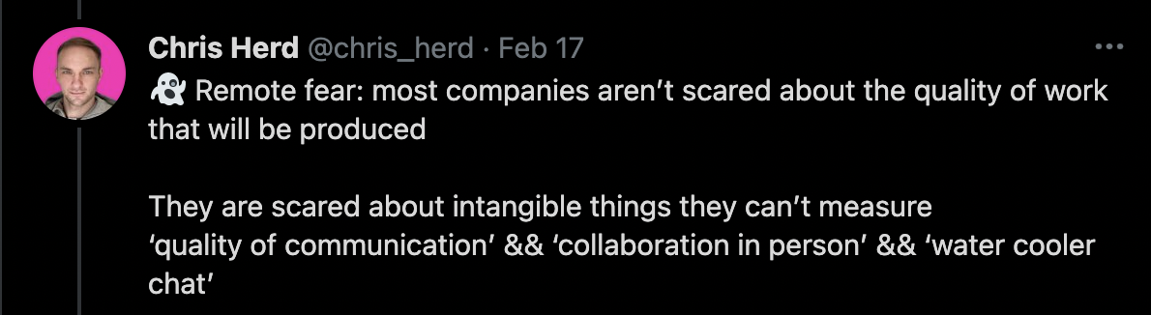
Trends in work-from-home
“We found that a lack of face-to-face interaction can lead to feelings of isolation and even paranoia” - Institute of Leadership & Management 2021[1]
[2]
The need for higher quality interactions between co-workers, similar to “water cooler” chat.
[1] “Going Remote: Leading Remote Teams” (ILM, 2021)
[2] Chris Herd, Head of “Remote Community” (Herd, 2021)

Slide 6
Our plan of attack
OBSERVE
Understand user pain points
Understand their context
Uncover their needs
Hear honest, unfettered feedback
REFLECT
Ideate , Test and Iterate
MAKE
Prototype & Iterate with User feedback

Slide 7
Schedule
 | Kai | Andre | Daniel | Jordaan
T-36 Hours to T-35 Hours | Customer needs | Customer needs | Customer needs | Customer needs
T-35 Hours to T-34 Hours | Brainstorming | Brainstorming | Brainstorming | Brainstorming
T-34 Hours to T-33 Hours | Talk to Sponsor Users | Talk to Sponsor Users | Talk to Sponsor Users | Talk to Sponsor Users
T-33 Hours to T-32 Hours | Brainstorm and team vote on idea | Brainstorm and team vote on idea | Brainstorm and team vote on idea | Brainstorm and team vote on idea
T-32 Hours to T-30.5 Hours | iOS dev | iOS dev | Website Back-end | Documentation & Video
T-30.5 Hours to T-30 Hours | Video Storyboard | Video Storyboard | Video Storyboard | Video Storyboard
T-30 Hours to T-24 Hours | Sleep | Sleep | Sleep | Sleep
T-24 Hours to T-23 Hours | Business Mentor Advice - Laura | Business Mentor Advice - Laura | Business Mentor Advice - Laura | Business Mentor Advice - Laura
T-23 Hours to T-22 Hours | Prototype | iOS dev | Website Back-end | Talk to Sponsor Users
T-22 Hours to T-21 Hours | Team alignment on Hills and Playback 0 | Team alignment on Hills and Playback 0 | Team alignment on Hills and Playback 0 | Team alignment on Hills and Playback 0
T-21 Hours to T-10 Hours | iOS dev | iOS dev | Finish website | Documentation & Video
T-10 Hours to T-7 Hours | Completion of iOS app | Video | Lend sockets expertise for completion of iOS app | Documentation & Video
T-7 Hours to T-4 Hours | Present completed work, discuss and make last minute tweaks | Present completed work, discuss and make last minute tweaks | Present completed work, discuss and make last minute tweaks | Present completed work, discuss and make last minute tweaks

Slide 8
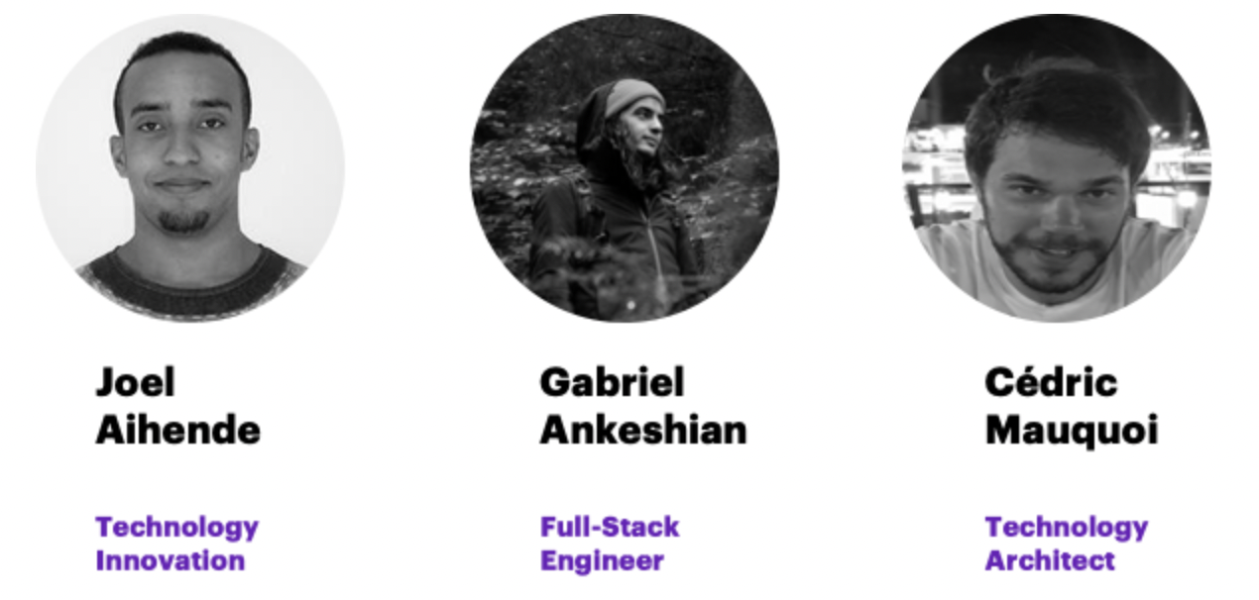
Our sponsor users
The Accenture team
Key CONSIDERATIONS
Our target users: People who work remotely
Context: Use work tools like Teams, Zoom, Skype and client-specific collab tools.
Needs: Higher quality social interactions with colleagues
‘People only talk when there’s need or an issue arises’

Slide 9
uSER PERSONAS & nEEDS
JOSH
PAULA
- 23 year old Accenture E2E Consulting employee.
- Lockdown isolation has been hard on his mental health.
- Recently onboarded and working from home.
- Microsoft Teams burnout.
- He can’t get to know his co-workers on a personal level.
- He has no flavour of the corporate culture.
- His conversations are limited to asking and answering questions about his work.
56 year old Citi retail bank employee.
Has been isolating for over a year and secretly suffers from depression.
Even before lockdown she struggled to get to know people at work. Many in her department are aged 20-30. Conversations just… wouldn’t happen. But there are lots of elderly people at Citi across the world.
She feels every conversation on Zoom takes place only when there’s a ‘need’ or an ‘issue’. It makes her worry for her job security.

Slide 10
We have team alignment ON OUR INTENT!

Slide 11
TEAM IDEATION: DIVERGE & CONVERGE
X2 Iterations
10 minutes - Individual Brainstorming
AND THEN…
20 minutes - Team reflection and Brainstorming on Miro

Slide 12
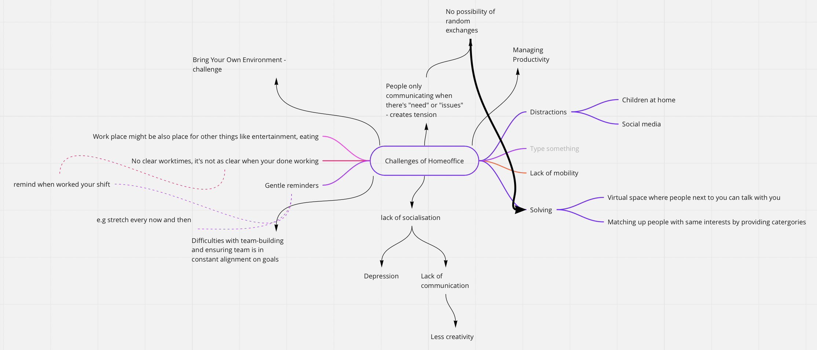
Our big ideas

Slide 13
KEY REFLECTION POINTS
Is The Team Aligned on Intent?
What idea did we vote for as a team?
Can other good ideas be merged or implemented later?
Are we still aligned on creating a human-first, work-centric socialisation platform?
Our reality
- Who are our stakeholders?
- What are our team’s capabilities?
- What can we not control/influence?
What Have We Learnt So Far?
- What insights have we gained?
- What is working?
- What is not working?
What’s Our Plan?
Delegate individual responsibilities based on project schedule
When will we reconvene for progress updates?
What additional resources might we need?

Slide 14
OUR VISION (“THE HILL”)
“Our company, Coffee Time, is developing a mobile app and website to help remote employees enjoy higher quality social interactions with co-workers via an algorithm that facilitates conversation, either at random or based upon shared interests you never even knew existed”
- Team 110%

Slide 15
pLAYBACK 0
sHARING LEARNINGS FROM 1st SPONSOR USER & business mentor FEEDBACK
OBSERVE | REFLECT | ITERATE
Feedback that people have too many apps so ours must add real value | Assess competitors using Competitive Arena to establish exactly where we are fulfilling a need | Remove 1-on-many chat functionality, focus on 1-on-1 richer conversations
Poor reception to idea of using QR codes attached to kettles to open the app | Team agrees this is unnecessary UI and results in additional user steps | Remove feature from prototype to simplify UI/Customer Journey
Positive reception to idea and progress from mentor. Encouraged to focus on pricing | Consider growth strategy | Incorporate Pricing Strategy

Slide 16
We ARE READY TO BEGIN DEVELOPMENT!

Slide 17
PROTOTYPE v1.0
MVP v1.0

Slide 18
pLAYBACK
OBSERVE (2nd Feedback from Accenture Team) | REFLECT | ITERATE
Very positive about the product, it’s scalability and potential impact on remote employees | Idea validated | Further validation upon completion of MVP 2.0
Advice to ensure documentation of teamwork and collaboration and avoid discussing finance/pricing in video. | Create “Our Journey” document to evidence collaboration through design principles. | Schedule additional time for “Our Journey” document. Move finance/pricing info to Pitch Deck.
Advice to ensure focus on user experience and value | Discussion of UX and value proposition | Further features added to Roadmap to validate.
Suggestion of a “swipe to match with colleagues for a chat” feature. | Discussion of feasibility with in timescale remaining | Swipe functionality added for moving from interests to one-off topics. Add swipe-to-chat feature to Roadmap.

Slide 19
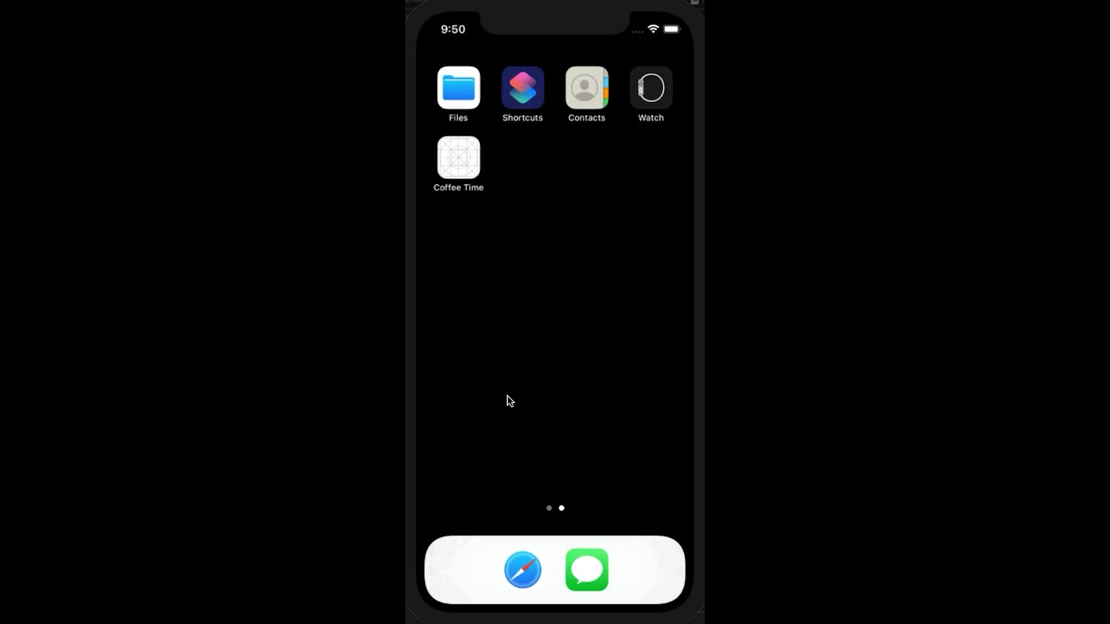
MVP v2.0
PROTOTYPE v2.0

Slide 20
Roadmap
wHAT mvp fEATURES TO DELIVER TO ensure THe “WOW” factor?
 | Features | User Benefits | Deadline
MVP v1.0 | User auth | Registration as member of team and save interests | 20/03/21
MVP v2.0 | User can see interests of other active users and choose to chat with a random user or by selecting a shared interest. | User can socialise with co-workers over non-work topics to build personal connections during quick break. Improved diversity and learning from others. | 21/03/21
MVP v3.0 | Implement audio call facility; user’s can consent to share contact info after the chat | Improved personal connections with remote co-workers by audio as well as chat. Develop long-term connections with new friends. | 25/03/21
MVP v4.0 | Implement user multi-channel capacity | User can be part of multiple separate channels so can form teams with non-colleagues. Increased chance of finding someone online with the same interests, | 28/03/21
=

Slide 21
ETHICS
Can employer use the app to identify a specific employee’s interests?
No - However, future possibility for employer to see interests of employees in aggregate to improve employer understanding of what employees are interested in and think, to provide alignment
Is there potential for abuse/trolling by strangers?
No - All channel users are provided an auth code by the organisation
Is data stored insecurely on the back-end?
No - Only data stored relates to employee interests. Once a user leaves the app any one-off topics they added as an interest disappear since there’s no indication they want to talk about this interest going forward.
Is user consent sought to begin a chat with another anonymous employee?
Yes

Slide 22
Reflection: dID WE MEET OUR TEAM GOALS?
Develop fully working prototype that
Allows user authentication as part of a team
Allows text chat functionality with someone else on the app at the same time based upon interests or at random.
Allows active users to add an interest/topic that disappears to all when they go offline.
The more active users with a certain interest, the larger the bubble representing that interest will be.
Has obtained feedback from Sponsor Users validating that Coffee Time solves a real pain point
Develop a self-explanatory, simple to use UI
Development of a Roadmap for further iterations to add user value
Work together effectively as a democratic, self-organising team

Slide 23
Thanks for hosting us!
And remember to get your coffee time….

